Slide 1
Project: Dog Rescue ATX

Slide 2
Purpose
To bring awareness to the importance of adoption by showing the number of stray dogs in the city and where they are found. Moreover, highlighting the work that organizations like Austin Pets Alive do to find homes for dogs in their care.

Slide 3
Data Sources
Dataset 1: Austin Animal Center Outcomes (csv)
Used for data exploration
Dataset 2: Austin Animal Center Stray Map (csv)
To map the stray dogs
Dataset 3: Austin Pets Alive! (Web scraping)
To collect visualize dog data in the shelter

Slide 4
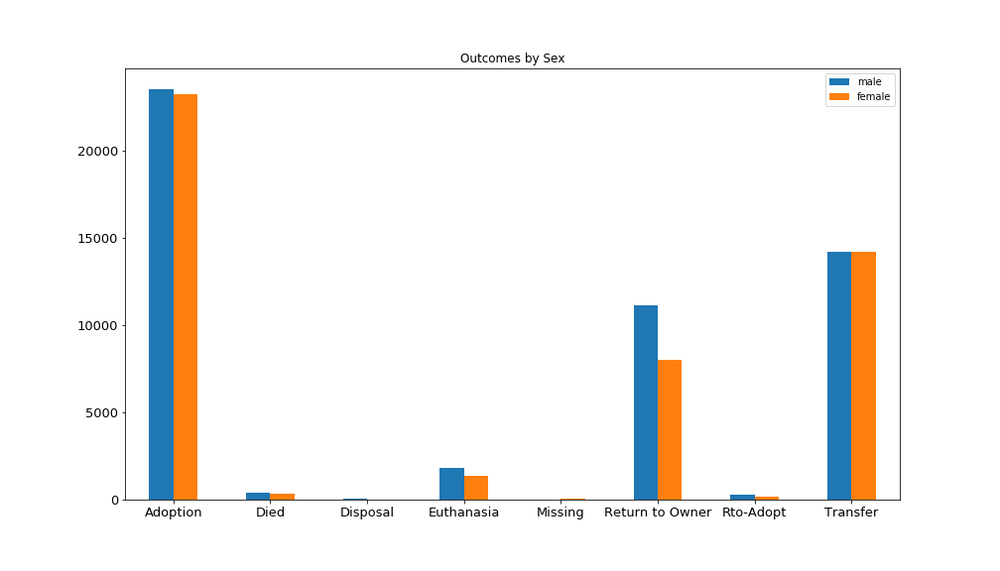

Slide 5
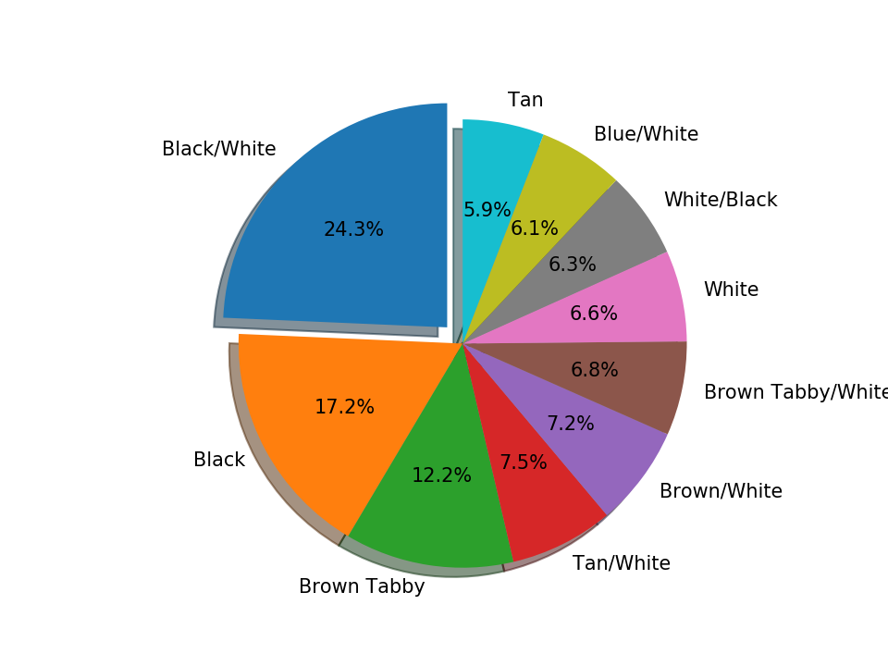

Slide 6
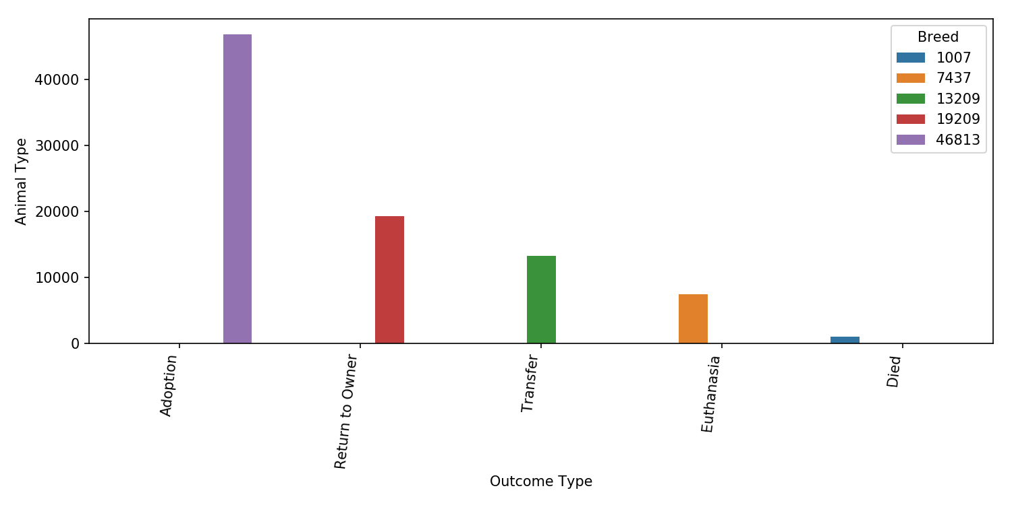

Slide 7
App Flow
APA Scrape
Data exploration:
Analyze data from dataset 1 to make further comparison against APA data
Scrape
MONGO
FLASK
HTML
Map data (csv)
AAC data (csv)
PYTHON
JS
PYTHON

Slide 8
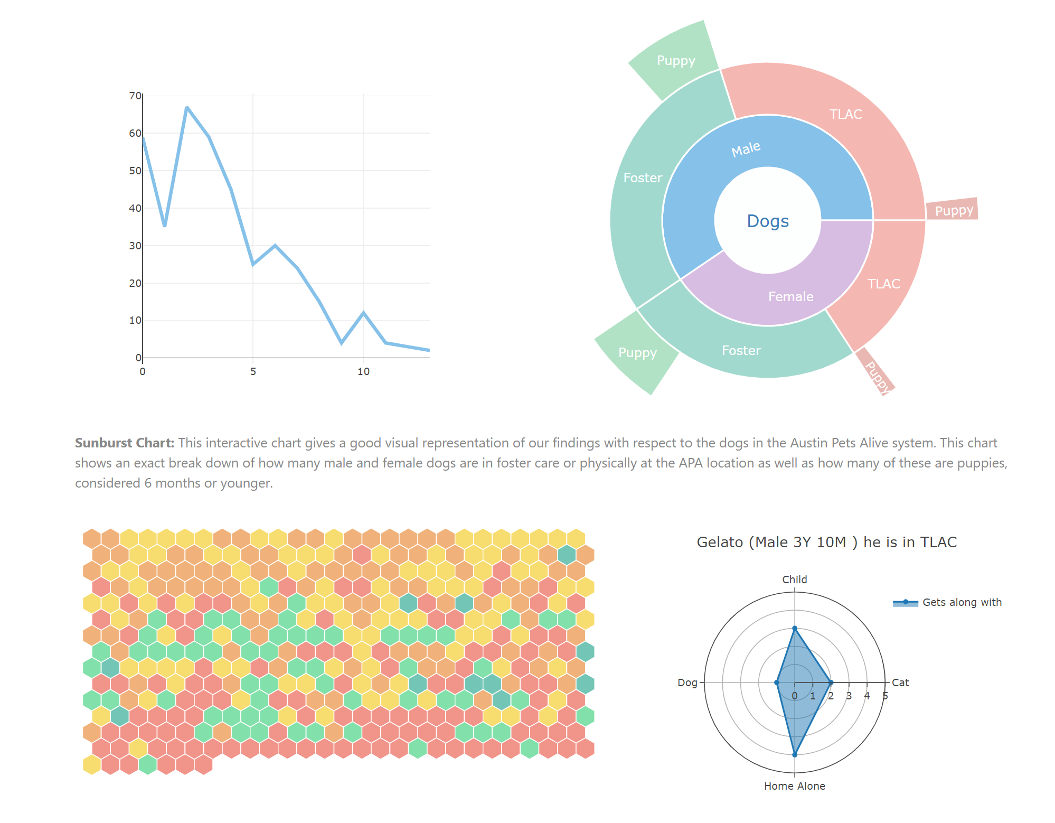
Application

